Slide 1
Applications of Trees
Course Code: 00090
Course Title: Discrete Mathematics
Dept. of Computer Science
Faculty of Science and Technology
Lecturer No: | 22 | Week No: | 12 | Semester: | Summer 21-22
Lecturer: | Md. Mahmudur Rahman (mahmudur@aiub.edu)

Slide 2
Lecture Outline
9.2 Applications of Trees
Binary Search Tree (BST)

Slide 3
Objectives and Outcomes
Objectives: To understand various applications of trees, to understand binary search tree (BST) and the algorithm for constructing binary search tree.
Outcomes: The students are expected to be able to explain applications of trees; be able to construct a BST from a given list of items.

Slide 4
Common Uses of Trees
Manipulate hierarchical data
Make information easy to search
Manipulate sorted lists of data
As a workflow for compositing digital images for visual effects
Routing Algorithms

Slide 5
Applications of Trees
Three problems can be studied using trees –
How should items in a list be stored so that an item can be easily located?
What series of decisions should be made to find an object with a certain property in a collection of objects of a certain type?
How should a set of characters be efficiently coded by bit strings?

Slide 6
Applications of Trees
Binary search tree
A simple data structure for sorted lists
Decision tree
A rooted tree where each vertex represents a possible outcome of a decision and the leaves represent the possible solutions
Minimum comparisons in sorting algorithms
Prefix code
A code that has the property that the code of a character is never a prefix of the code of another character
Huffman coding

Slide 7
Binary Search Tree (BST)
A binary tree in which each child of a vertex is designated as a right or left child.
No two vertex has more than one right child or left child, and each vertex is labeled with a key, which is one of the items.
Vertices are assigned keys so that the key of a vertex is both larger than the keys of all vertices in its left subtree and smaller than the keys of all vertices in its right subtree.

Slide 8
Binary Search Trees (BST)
Binary Search Tree (BST): A binary tree in which the vertices are labeled with items so that a label of a vertex is greater than the labels of all vertices in the left subtree of this vertex and is less than the labels of all vertices in the right subtree of this vertex.

Slide 9
Binary Search Trees (BST): Example
Items are stored at individual tree nodes.
We arrange for the tree to always obey this invariant:
For every item x,
Every node in x’s left subtree is less than x.
Every node in x’s right subtree is greater than x.
7
3
12
1
5
9
15
0
2
8
11
9

Slide 10
Is this a BST?
5
4
3
2
7
8
9
No, this is NOT a BST. Why?

Slide 11
Binary Search Trees (BST)
Binary search tree construction Algorithm
Start with a tree containing just one vertex (the root).
Let v = the root.
To add a new item a, do the following until stop:
If a< v:
If v has a left child, then v = left child of v(move to the left)
Else add a new left child to v with this item as its key.
Stop.
If a> v:
If v has a right child, then v= right child of v(move to the right).
Else add a new right child to v with this item as its key.
Stop.

Slide 12
Construction of BST
Example: Construct/Form a BST using the numbers below.
5 9 8 1 2 4 6 10

Slide 13
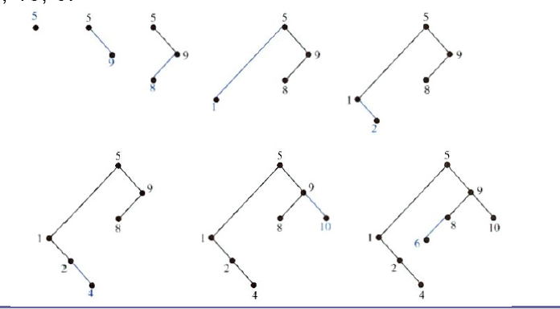
Construction of BST
5 9 8 1 2 4 6 10

Slide 14
Class Work
Construct/Form a BST using the numbers below.
13, 3, 4, 12, 14, 10, 5, 1, 8, 2, 7, 9, 11, 6, 18

Slide 15
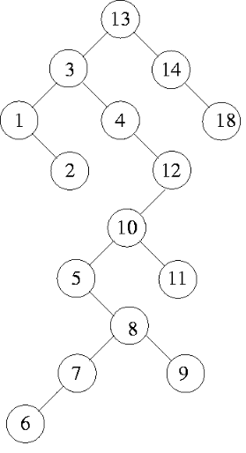
13, 3, 4, 12, 14, 10, 5, 1, 8, 2, 7, 9, 11, 6, 18
Solution

Slide 16
Example 1
EXAMPLE 1: Form a binary search tree for the words mathematics, physics, geography, zoology, meteorology, geology, psychology, and chemistry (using alphabetical order).

Slide 17
Solution of Example 1
Solution: Figure 1 displays the steps used to construct this binary search tree.
The word mathematics is the key of the root. Because physics comes after
mathematics (in alphabetical order), add a right child of the root with key
physics. Because geography comes before mathematics, add a left child of the
root with key geography. Next, add a right child of the vertex with key physics,
and assign it the key zoology, because zoology comes after mathematics and
after physics. Similarly, add a left child of the vertex with key physics and
assign this new vertex the key meteorology. Add a right child of the vertex
with key geography and assign this new vertex the key geology. Add a left
child of the vertex with key zoology and assign it the key psychology. Add a
left child of the vertex with key geography and assign it the key chemistry.
(The reader should work through all the comparisons needed at each step.)

Slide 18
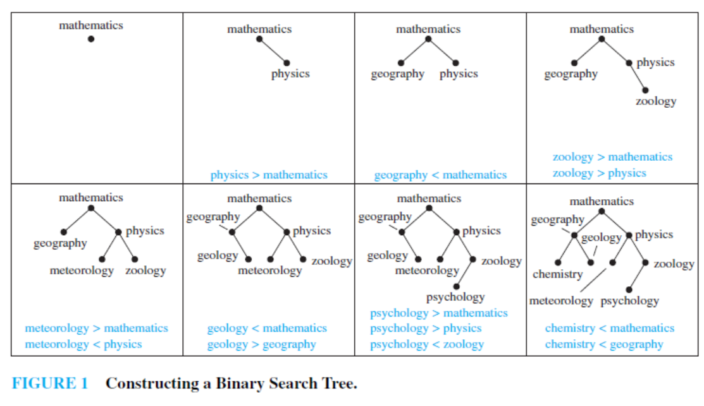
Solution of Example 1
mathematics, physics, geography, zoology, meteorology, geology, psychology, and chemistry

Slide 19
Class work
Exercise 1: Build a binary search tree for the words banana, peach, apple, pear, coconut, mango, and papaya using alphabetical order.
Exercise 5: Using alphabetical order, construct a binary search tree for the words in the sentence
“The quick brown fox jumps over the lazy dog.”

Slide 20
Books
Rosen, K. H., & Krithivasan, K. (2012). Discrete mathematics and its applications: with combinatorics and graph theory. Tata McGraw-Hill Education. (7th Edition)

Slide 21
References
Discrete Mathematics, Richard Johnsonbaugh, Pearson education, Inc.
Discrete Mathematical Structures, Bernard Kolman, Robert C. Busby, Sharon Ross, Prentice-Hall, Inc.
SCHAUM’S outlines Discrete Mathematics(2nd edition), by Seymour Lipschutz, Marc Lipson
University of Wisconsin-Madison
http://pages.cs.wisc.edu/~deppeler/cs367-common/readings/Trees/intro.html
Bradfield School of Computer Science
https://bradfieldcs.com/algos/trees/introduction/
Online tutorial https://www.javatpoint.com/discrete-mathematics-binary-search-trees
Istanbul Technical University https://web.itu.edu.tr/~gencata/courses/DM/trees.pdf

